Slide 1
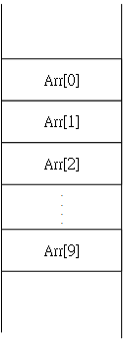
Contiguous Array or Linked List?
#include <stdio.h>
#include <stdlib.h>
typedef struct _node {
int x;
} Node;
Node Arr[10];

Slide 2
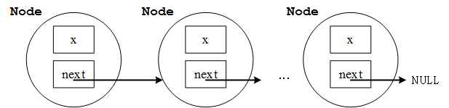
Contiguous Array or Linked List?
#include <stdio.h>
#include <stdlib.h>
typedef struct _node {
int x;
struct _node *next;
} Node;
Linked-list approach: 程式執行當下決定增加或減少一個Node => 更有彈性!

Slide 3
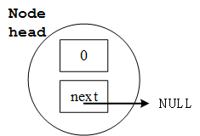
int main(void)
{
Node head;
head.x = 0;
head.next = NULL; //NULL == 0x00000000

Slide 4
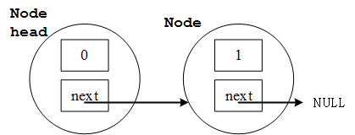
int main(void)
{
Node head;
head.x = 0;
head.next = NULL; //NULL == 0x00000000
head.next = (Node *) malloc (sizeof(Node));
(head.next)->x = 1;
(head.next)->next = NULL;
printf("%d %d\n", head.x, (head.next)->x);
free(head.next);
return 0;
}

Slide 5
Linked Lists: A Complete Example
#include <stdio.h>
#include <stdlib.h>
typedef struct _node {
int x;
struct _node *next;
} Node;
/*
head|x|next|
|
V
|x|next|
|
V
np-> |x|next|
*/

Slide 6
int main(void)
{
Node head;
Node *np, *nq;
int i;
head.x = 0;
head.next = (Node *) malloc(sizeof(Node));
np = head.next;
i = 1;
while (i < 10) {
np->x = i;
np->next = (Node *) malloc(sizeof(Node));
np = np->next;
i++;
}
np->x = i;
np->next = NULL;
np = head.next;
while (np!=NULL) {
printf("%d\n", np->x);
np = np->next;
}

Slide 7
np = head.next;
while (np!=NULL) {
nq = np;
np = np->next;
free(nq);
}
return 0;
}

Slide 8
nq
np
nq
np
np
np
np
int main(void)
{
Node head;
Node *np, *nq;
int i;
head.x = 0;
head.next = (Node *) malloc(sizeof(Node));
np = head.next;
i = 1;
while (i < 10) {
np->x = i;
np->next = (Node *) malloc(sizeof(Node));
np = np->next;
i++;
}
np->x = i;
np->next = NULL;
np = head.next;
while (np!=NULL) {
printf("%d\n", np->x);
np = np->next;
}
np = head.next;
while (np!=NULL) {
nq = np;
np = np->next;
free(nq);
}
return 0;
}
head
np
datax=0
Link
next
data
Link
next
data
Link
next
x=1
x=2
np
data
Link
next
data
Link
next
data
Link
next
i==10
x=3
x=4
x=5
依此類推
data
Link
next
data
Link
next
data
Link
next
x=6
x=7
x=8
np==NULL
nq
np
np
np
np
Print 10
np
Print 1
依此類推印到10
data
Link
next
data
Link
next
NULL
np==NULL
x=9
x=10
依此類推
return

